Slide 1
Capstone Project - AllianceBernstein
Weekly Update
3.20
Hongyu Dai

Slide 2
Previous takeaway
CA data
code tuning
TX data analysis
Relatetion with house price

Slide 3
Summary - CA data
Finish code final tunning.
Number of files ~= 20type*5years*55county*4avg reports = 20,000
Total run time ~ 30hr
Currently:
Program is still running -> both local & aws ec2
Partly uploaded

Slide 4
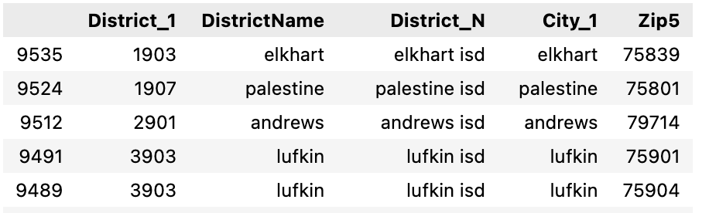
Summary - TX data
Improvement on data analysis
Relabel data with corresponding district names
Option to display Top xx districts (eg. top 100 by average value)
Add annotations for selected elements
Include average as benchmark for comparison
Explore the relationship with Household income
Still working on: Gather and organize distinct & zipcode datasheets.
Issue: TX education file have multiple distinct & zipcode mapping, still consider how to determine final distinct & zipcode mapping
….

Slide 5
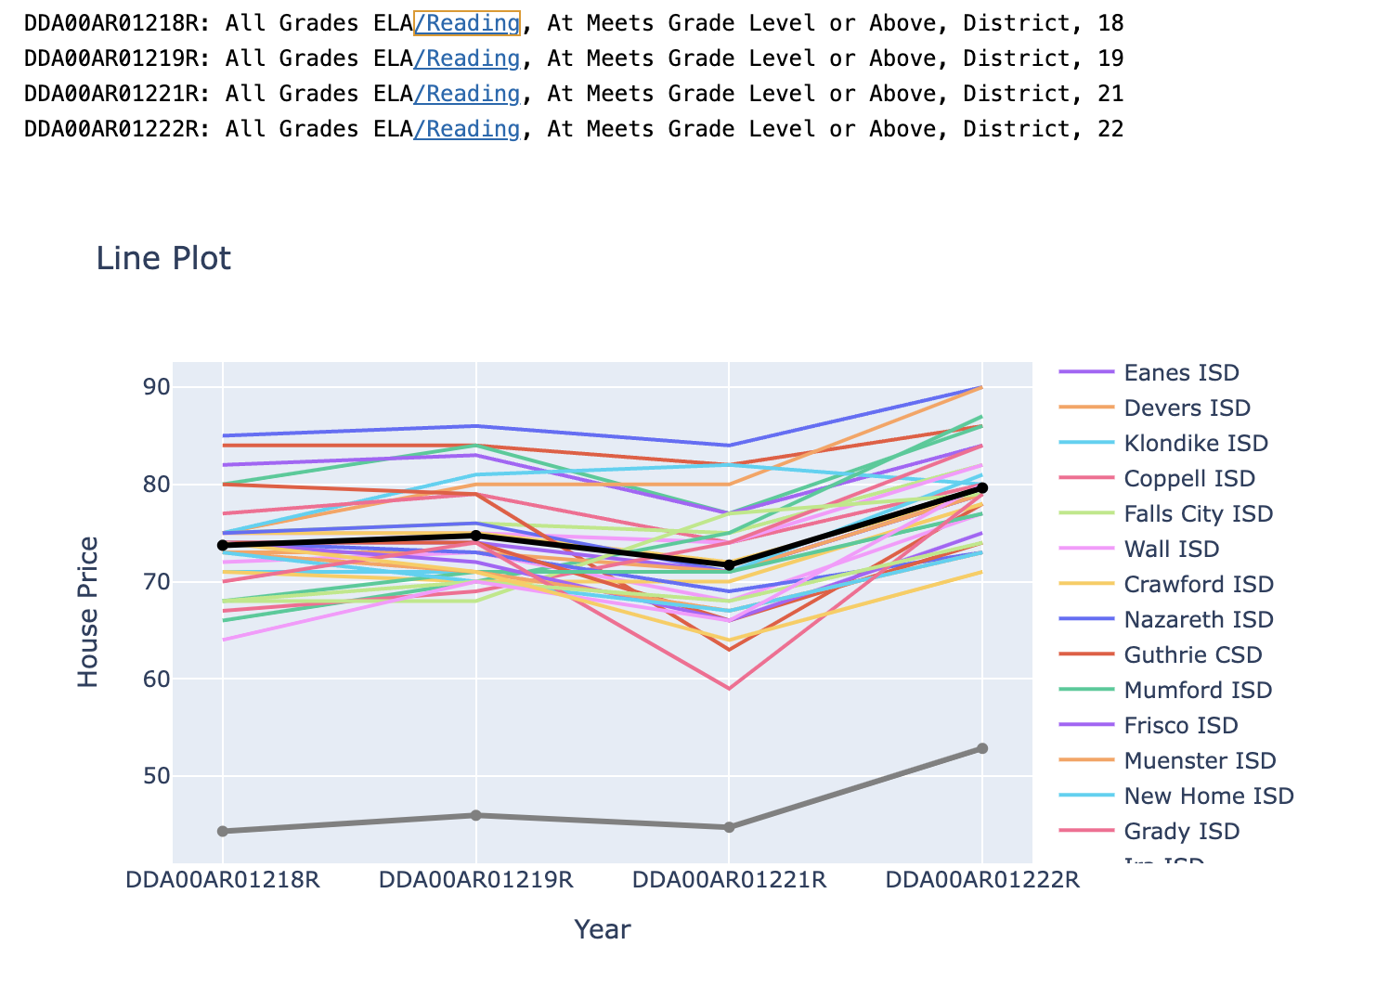
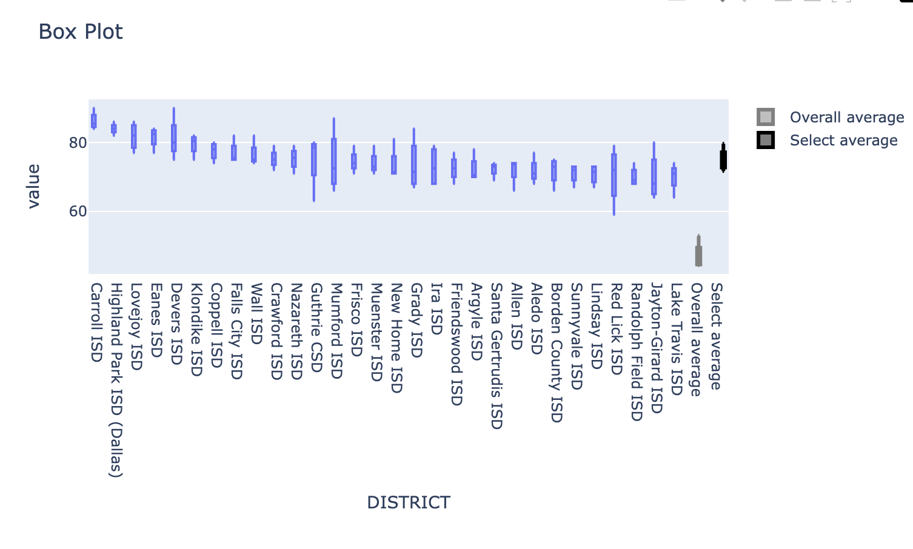
Plot example

Slide 6
Next Step
Fix zipcode error
House price/ Household income analysis
Question:
How to mapping Geography & zipcode
Any key features we would like to pay special attention to

